Slide 1
Gradient Descent

Slide 2
Gradient Descent
Algorithmic method for finding a local minimum of a differentiable function.
The algorithm is initiated by choosing random values to the parameters
Improve the parameters gradually by taking steps proportional to the negative of the gradient (or approximate gradient) of the cost function at the current point.
Continue the process until the algorithm converges to a minimum i.e until the difference between the successive iterates becomes stable or reaches a threshold
Note: If we instead take steps proportional to the positive of the gradient, we approach a local maximum of that function; the procedure is then known as gradient ascent.

Slide 3
Analogy
To get an idea of how Gradient Descent works, let us take an example. Suppose you are at the top of a mountain and want to reach the base camp which is all the way down at the lowest point of the mountain. Also, due to the bad weather, the visibility is really low and you cannot see the path at all. How would you reach the base camp?
One of the ways is to use your feet to know where the land tends to descend. This will give an idea in what direction, the steep is low and you should take your first step. If you follow the descending path until you encounter a plain area or an ascending path, it is very likely you would reach the base camp.

Slide 4
Analogy

Slide 5
Limitation
If there is a slight rise in the ground when you are going downhill you would immediately stop assuming that you reached the base camp (global minima), but in reality, you are still stuck at the mountain at a local minima.
In other words , gradient descent does not guarantee finding global minima (maxima) of the function
However most of the objective functions used in machine learning such as cost function are convex functions which ensure that the local minimum is also a global minimum.

Slide 6
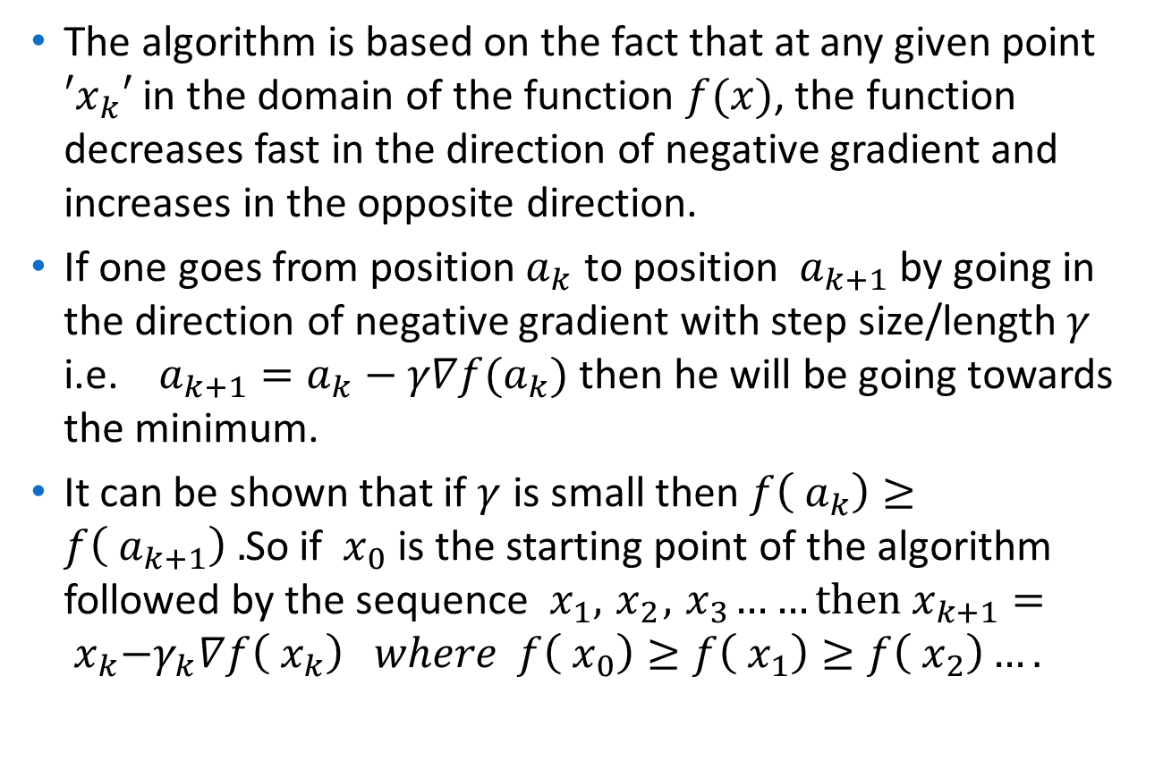
Mathematical formulation of the idea:
The algorithm is based on the fact that at any given point $′x_{k}′$ in the domain of the function $f(x)$, the function decreases fast in the direction of negative gradient and increases in the opposite direction.
If one goes from position${ a}_{k}$ to position ${ a}_{k+1}$ by going in the direction of negative gradient with step size/length $γ$ i.e. $a_{k+1}=a_{k}−γ∇f(a_{k})$ then he will be going towards the minimum.
It can be shown that if $γ$ is small then $f\left({ a}_{k}\right)≥f\left({ a}_{k+1}\right) .$So if ${ x}_{0}$ is the starting point of the algorithm followed by the sequence ${ x}_{1},{ x}_{2},{ x}_{3}……then$ $x_{k+1}={ x}_{k}−γ_{k}∇f\left({ x}_{k}\right) where f\left({ x}_{0}\right)≥f\left({ x}_{1}\right)≥f\left({ x}_{2}\right)….$

Slide 7
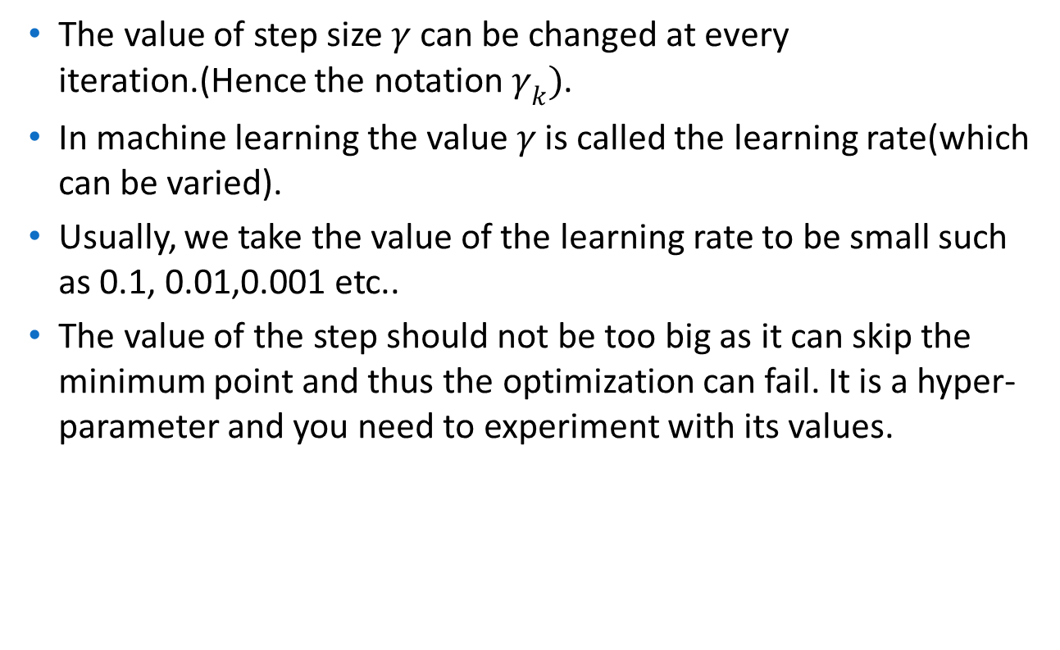
Note on Step Size
The value of step size $γ$ can be changed at every iteration.(Hence the notation $γ_{k})$.
In machine learning the value $γ$ is called the learning rate(which can be varied).
Usually, we take the value of the learning rate to be small such as 0.1, 0.01,0.001 etc..
The value of the step should not be too big as it can skip the minimum point and thus the optimization can fail. It is a hyper-parameter and you need to experiment with its values.

Slide 8
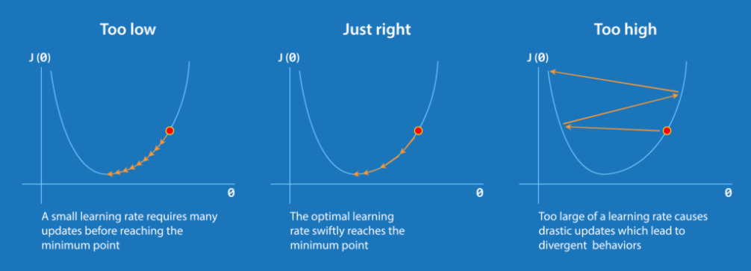
Note on Step Size

Slide 9
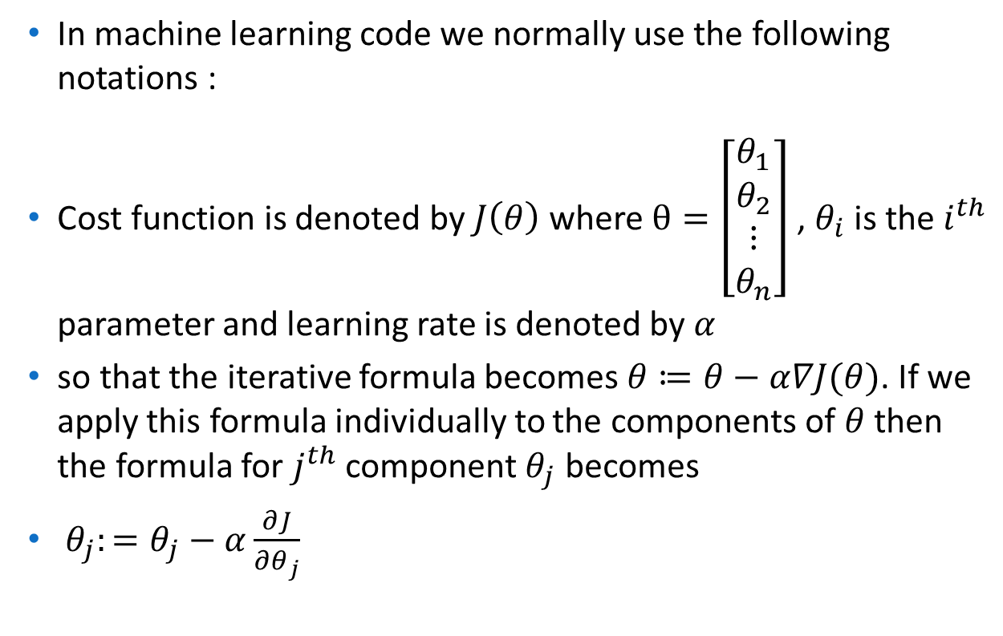
Algorithm in Machine Learning
In machine learning code we normally use the following notations :
Cost function is denoted by $J\left(θ\right)$ where $θ=\left[\begin{matrix}θ_{1} \\ θ_{2} \\ \begin{matrix}⋮ \\ θ_{n}\end{matrix}\end{matrix}\right]$ , $θ_{i}$ is the $i^{th}$ parameter and learning rate is denoted by $α$
so that the iterative formula becomes $θ≔θ−α∇J(θ)$. If we apply this formula individually to the components of $θ$ then the formula for $j^{th}$ component $θ_{j}$ becomes
$θ_{j}:=θ_{j}−α\frac{∂J}{∂θ_{j}}$

Slide 10
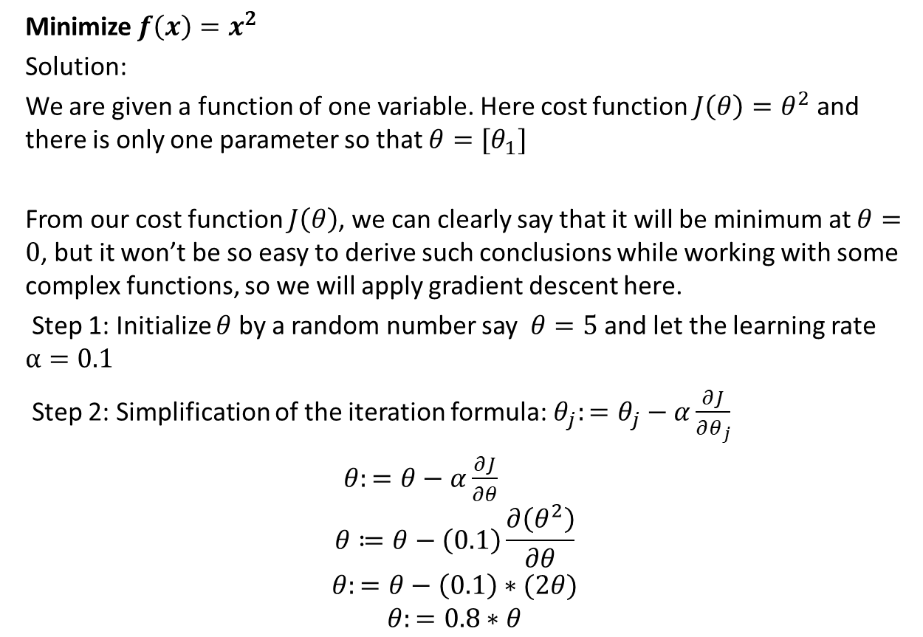
Example: Single Variable Case
Minimize $f\left(x\right)=x^{2}$
Solution:
We are given a function of one variable. Here cost function $J\left(θ\right)=θ^{2}$ and there is only one parameter so that $θ={[θ}_{1}]$
From our cost function $J\left(θ\right)$, we can clearly say that it will be minimum at $θ=0$, but it won’t be so easy to derive such conclusions while working with some complex functions, so we will apply gradient descent here.
Step 1: Initialize $θ$ by a random number say $θ=5$ and let the learning rate $α=0.1$
Step 2: Simplification of the iteration formula: $θ_{j}:=θ_{j}−α\frac{∂J}{∂θ_{j}}$
$θ:=θ−α\frac{∂J}{∂θ}$
$$θ≔θ−\left(0.1\right)\frac{∂\left(θ^{2}\right)}{∂θ}$$
$$θ:=θ−\left(0.1\right)∗(2θ)$$
$$θ:=0.8∗θ$$

Slide 11
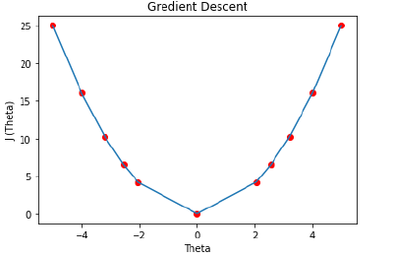
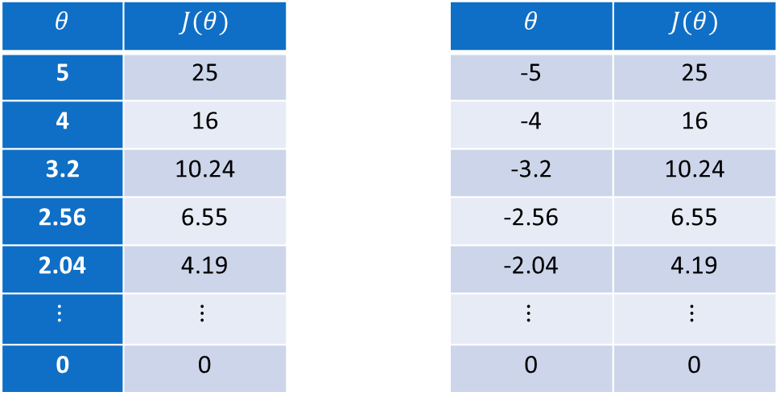

Example: Single Variable Case
Table Generation:
Here we are stating with θ = 5.keep in mind that here θ = 0.8*θ, for our learning rate and cost function.
We can see that, as we increase our number of iterations, our cost value goes down and the algorithm converges to the optimum value $0$
$$θ$$ | $$J(θ)$$ |  | $$θ$$ | $$J(θ)$$
5 | 25 |  | -5 | 25
4 | 16 |  | -4 | 16
3.2 | 10.24 |  | -3.2 | 10.24
2.56 | 6.55 |  | -2.56 | 6.55
2.04 | 4.19 |  | -2.04 | 4.19
$$⋮$$ | $$⋮$$ |  | $$⋮$$ | $$⋮$$
0 | 0 |  | 0 | 0

Slide 12
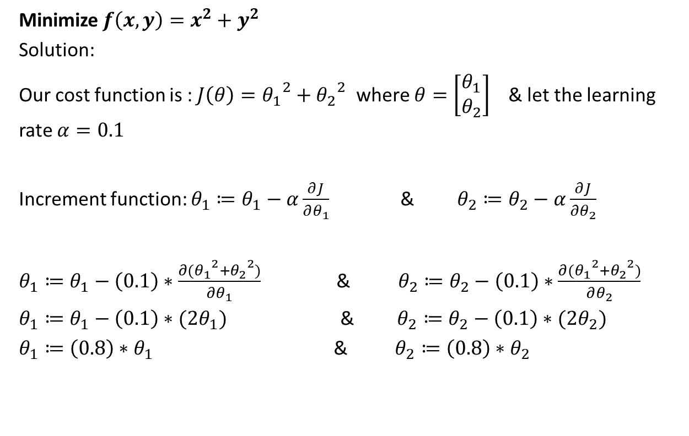
Example: Two Variable Case
Minimize $f\left(x,y\right)=x^{2}+y^{2}$
Solution:
Our cost function is : $J\left(θ\right)={θ_{1}}^{2}+{θ_{2}}^{2}$ where $θ=\left[\begin{matrix}θ_{1} \\ θ_{2}\end{matrix}\right]$ & let the learning rate $α=0.1$
Increment function: $θ_{1}≔θ_{1}−α\frac{∂J}{∂θ_{1}}$ & $θ_{2}≔θ_{2}−α\frac{∂J}{∂θ_{2}}$
$θ_{1}≔θ_{1}−\left(0.1\right)∗\frac{∂({θ_{1}}^{2}+{θ_{2}}^{2})}{∂θ_{1}}$ & $θ_{2}≔θ_{2}−\left(0.1\right)∗\frac{∂({θ_{1}}^{2}+{θ_{2}}^{2})}{∂θ_{2}}$
$θ_{1}≔θ_{1}−\left(0.1\right)∗(2θ_{1})$ & $θ_{2}≔θ_{2}−\left(0.1\right)∗(2θ_{2})$
$θ_{1}≔\left(0.8\right)∗θ_{1}$ & $θ_{2}≔\left(0.8\right)∗θ_{2}$

Slide 13
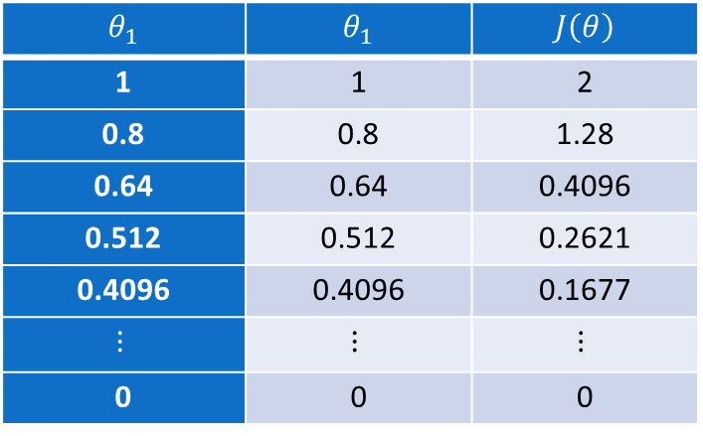

Example: Two Variable Case
Table Generation:
Initialize $θ_{1}=1 \& θ_{2}=1$ and iterate
We can see that, as we increase our number of iterations, our cost value goes down and the algorithm slowly converges to the optimum value $(0,0)$
$$θ_{1}$$ | $$θ_{1}$$ | $$J\left(θ\right)$$
1 | 1 | 2
0.8 | 0.8 | 1.28
0.64 | 0.64 | 0.4096
0.512 | 0.512 | 0.2621
0.4096 | 0.4096 | 0.1677
$$⋮$$ | $$⋮$$ | $$⋮$$
0 | 0 | 0

